Slide 1
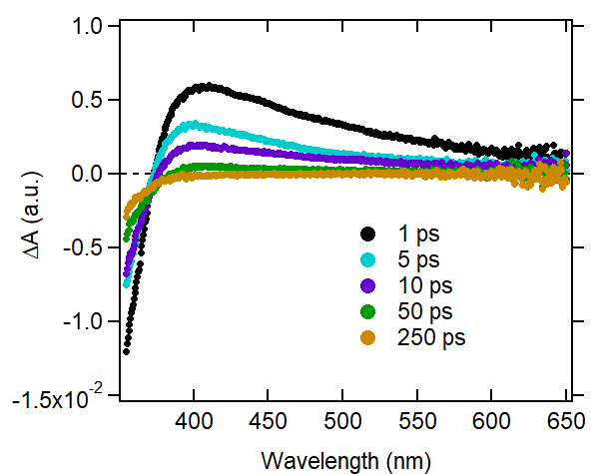
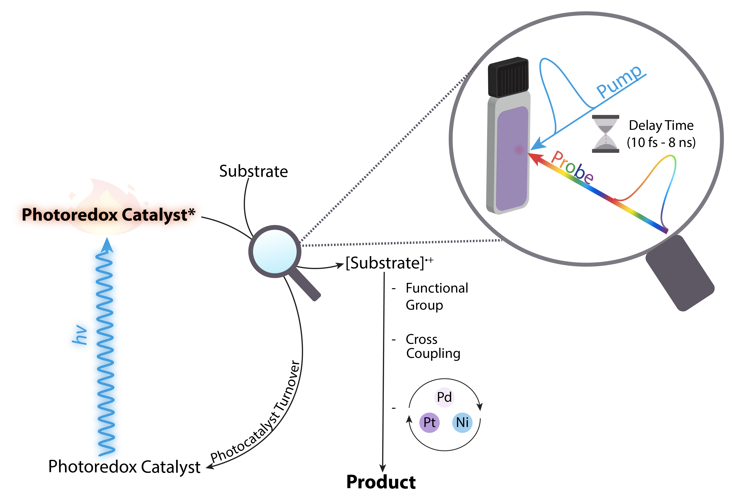
Research in the Kudisch Lab:
Introduction to photochemical and photophysical dynamics and kinetics
v
v
Bryan Kudisch
Assistant Professor
Department of Chemistry & Biochemistry
Florida State University
Photochemistry Café, July 16th, 2024

Slide 2
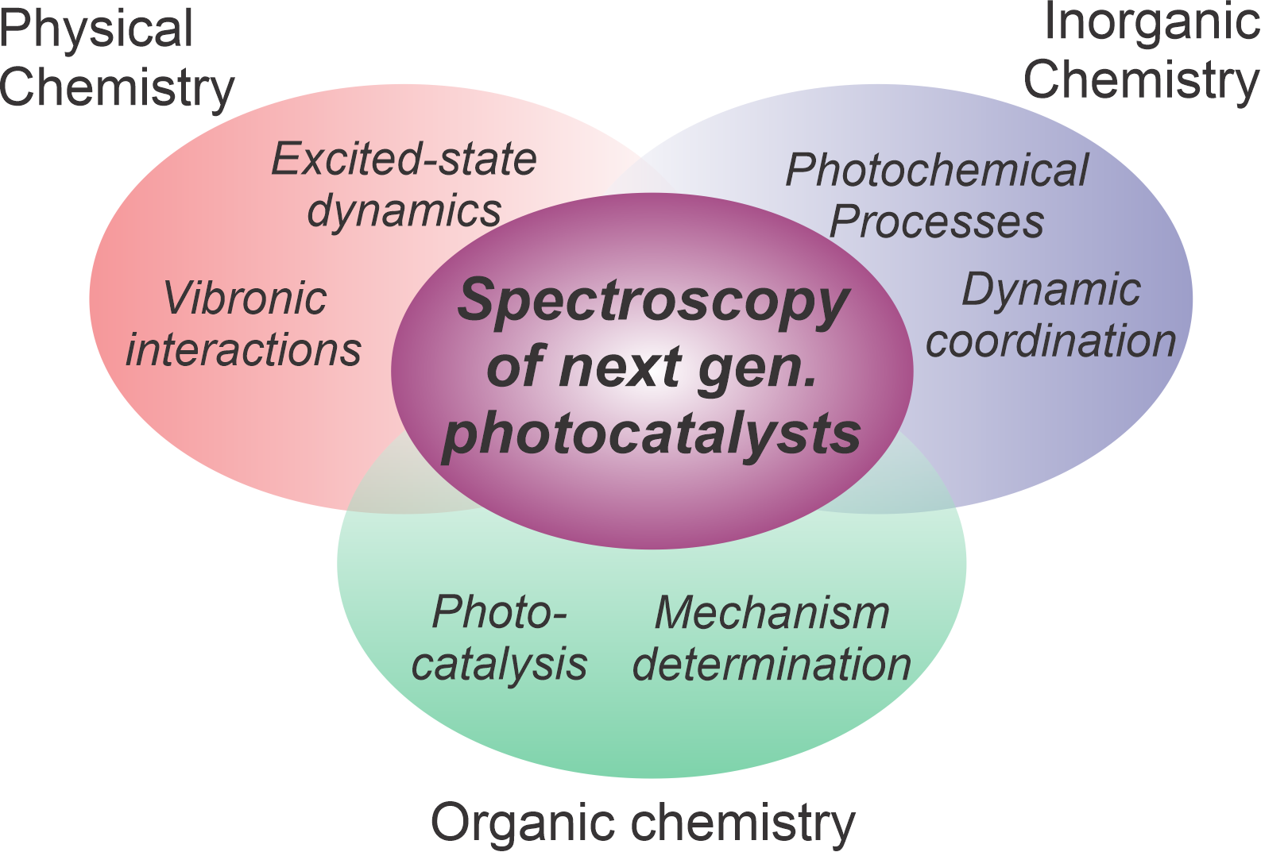
At the intersection of physical, organic, and inorganic chemistry

Slide 3
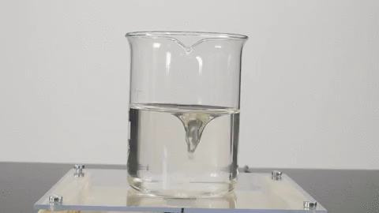
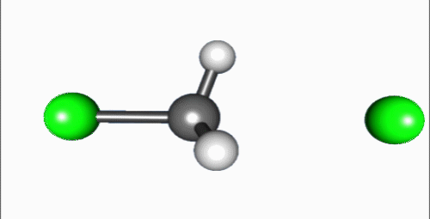
How do you think about chemical reactions as they are happening?

Slide 4
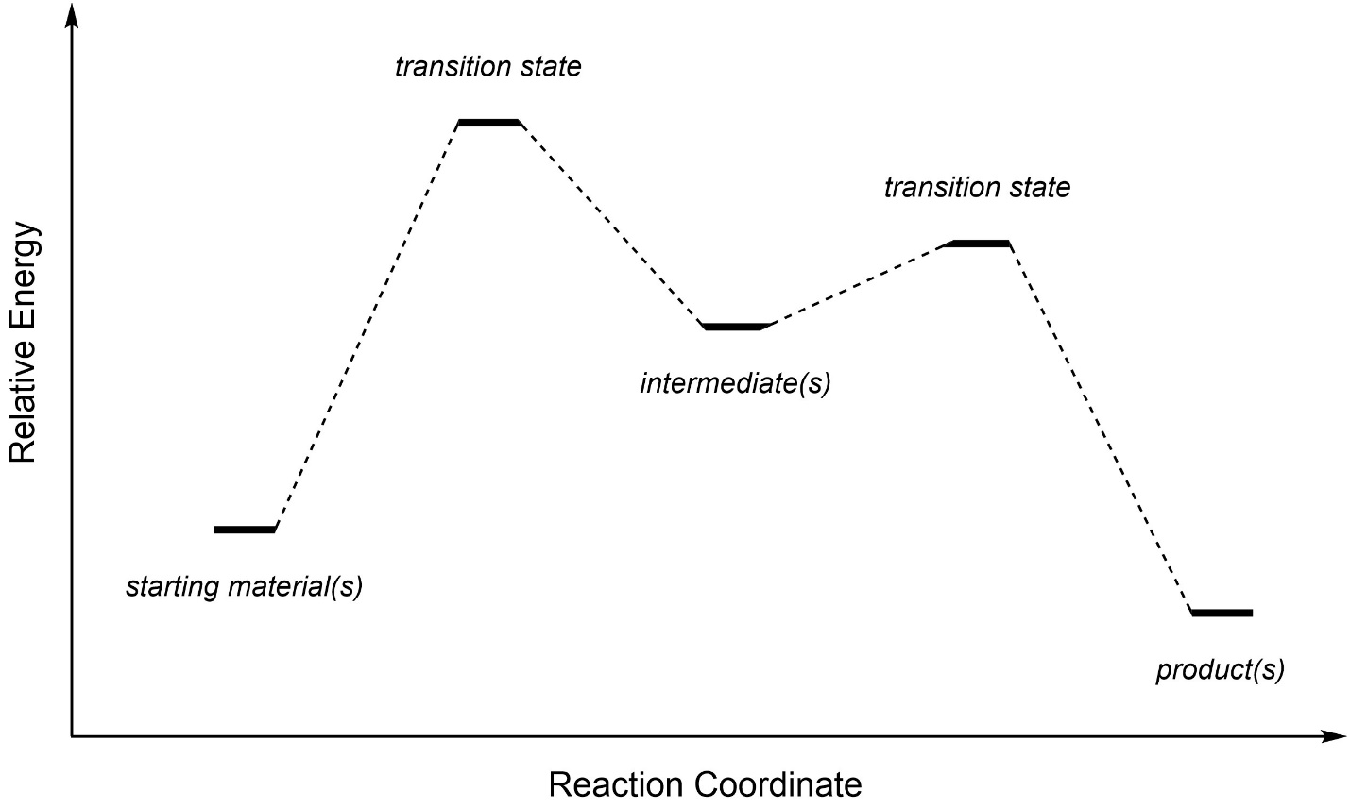
Relevant vocabulary in chemical dynamics
Reaction coordinate
An abstract one-dimensional coordinate that represents progress along a reaction pathway
  A roadmap of relevant transition states, intermediates, and their energies
Transition state
The lowest energy configuration needed to convert between two species
  On a lineararized reaction coordinate, the highest energy configuration between two species
Intermediate
A relatively high-energy species that exists as a local minimum on a reaction coordinate

Slide 5
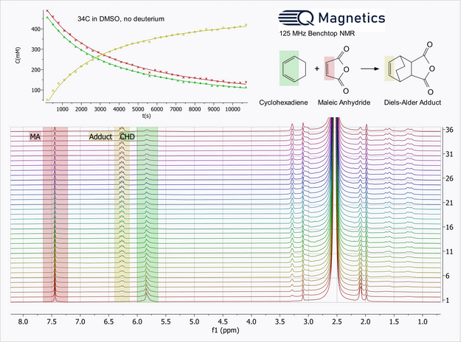
Great, awesome, cool—now show me a reaction happening

Slide 6
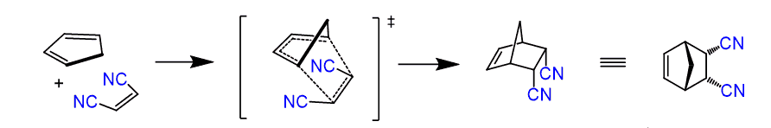
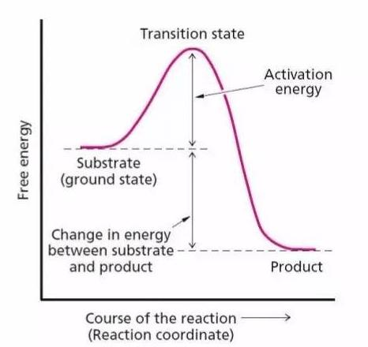
What about all of that fun stuff in between?
Transition states live for ~10 fs, or 10⁻¹⁴ s

Slide 7
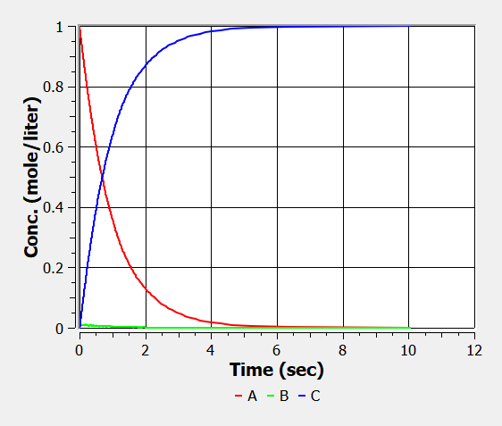



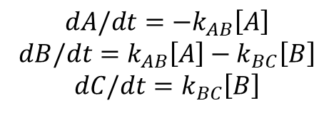
The inverted kinetics problem
$$B$$
A simulation with fake numbers, this is with k_{BC} = 100k_{AB}
$$A$$
$$C$$
k_{AB}
k_{BC}
$$A →B→C$$
$$dA/dt={−k}_{AB}\left[A\right]$$
$$dB/dt=k_{AB}\left[A\right]−k_{BC}\left[B\right]$$
$$dC/dt=k_{BC}\left[B\right]$$
You never see a significant “buildup” of B, if it’s being consumed faster than it’s being formed.
→Inverted kinetics
In the “transition state” situation, this corresponds to
$$\text{k}\text{B}\text{C} ≫\text{k}\text{AB}$$

Slide 8
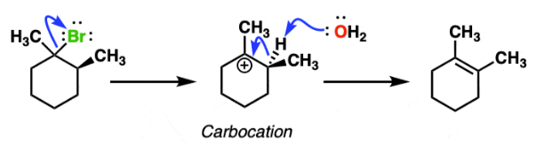


A pervasive (but more addressable) problem for intermediates
$$k_{A→INT}=A′exp(−\frac{∆G\text{′}\text{‡}}{k_{B}T})$$
$$k_{INT→B}=A′′exp(−\frac{∆G′′\text{‡}}{k_{B}T})$$
So, what about for the diagram on the left?
It would still have inverted kinetics, since the free energy barrier for the second step is smaller than the first
At least, though, this gives hope that some reactions do have intermediates that “build up” and thus have reactions you can see

Slide 9
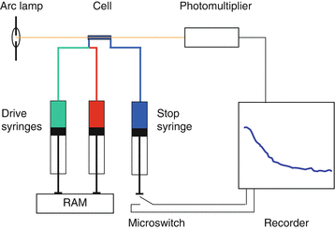
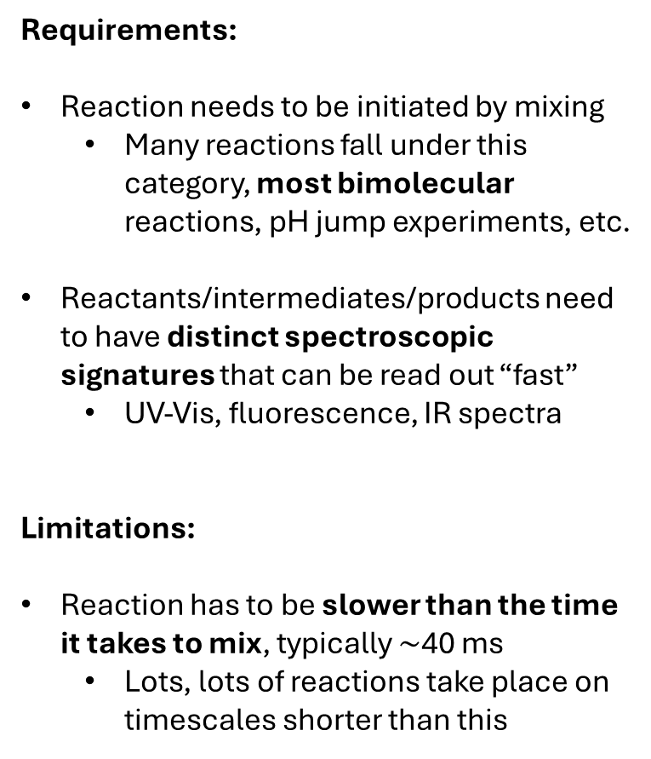

Experimental tricks to see reaction intermediates/elementary steps
Requirements:
Reaction needs to be initiated by mixing
  Many reactions fall under this category, most bimolecular reactions, pH jump experiments, etc.
Reactants/intermediates/products need to have distinct spectroscopic signatures that can be read out “fast”
  UV-Vis, fluorescence, IR spectra
Limitations:
Reaction has to be slower than the time it takes to mix, typically $\sim$40 ms
  Lots, lots of reactions take place on timescales shorter than this
$$A+B→I→C$$
If we can mix A and B faster than they form I or C, then we track the reaction kinetics
Stopped-flow apparatus

Slide 10
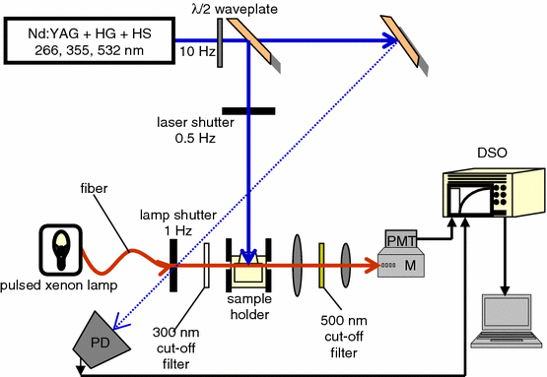
Chemical kinetics on faster timescales: nanosecond flash photolysis
Requirements:
Pulsed laser source (~5 ns pulses are typical)
  Can generate up to mM concentrations of excited-states
Fast detection electronics
  Typically 10s of nanosecond (10⁻⁹ s)
Detectable intermediates/products
Let’s say I want to know the rate of this reaction.
Expect it to be fast, since it’s a radical reaction
So, we have to make the reactants faster than two radicals couple together!
The trick is to use a pulse of light that rapidly generates the reactants
As long as these two steps are faster than the one of interest, this is kinetically possibly

Slide 11
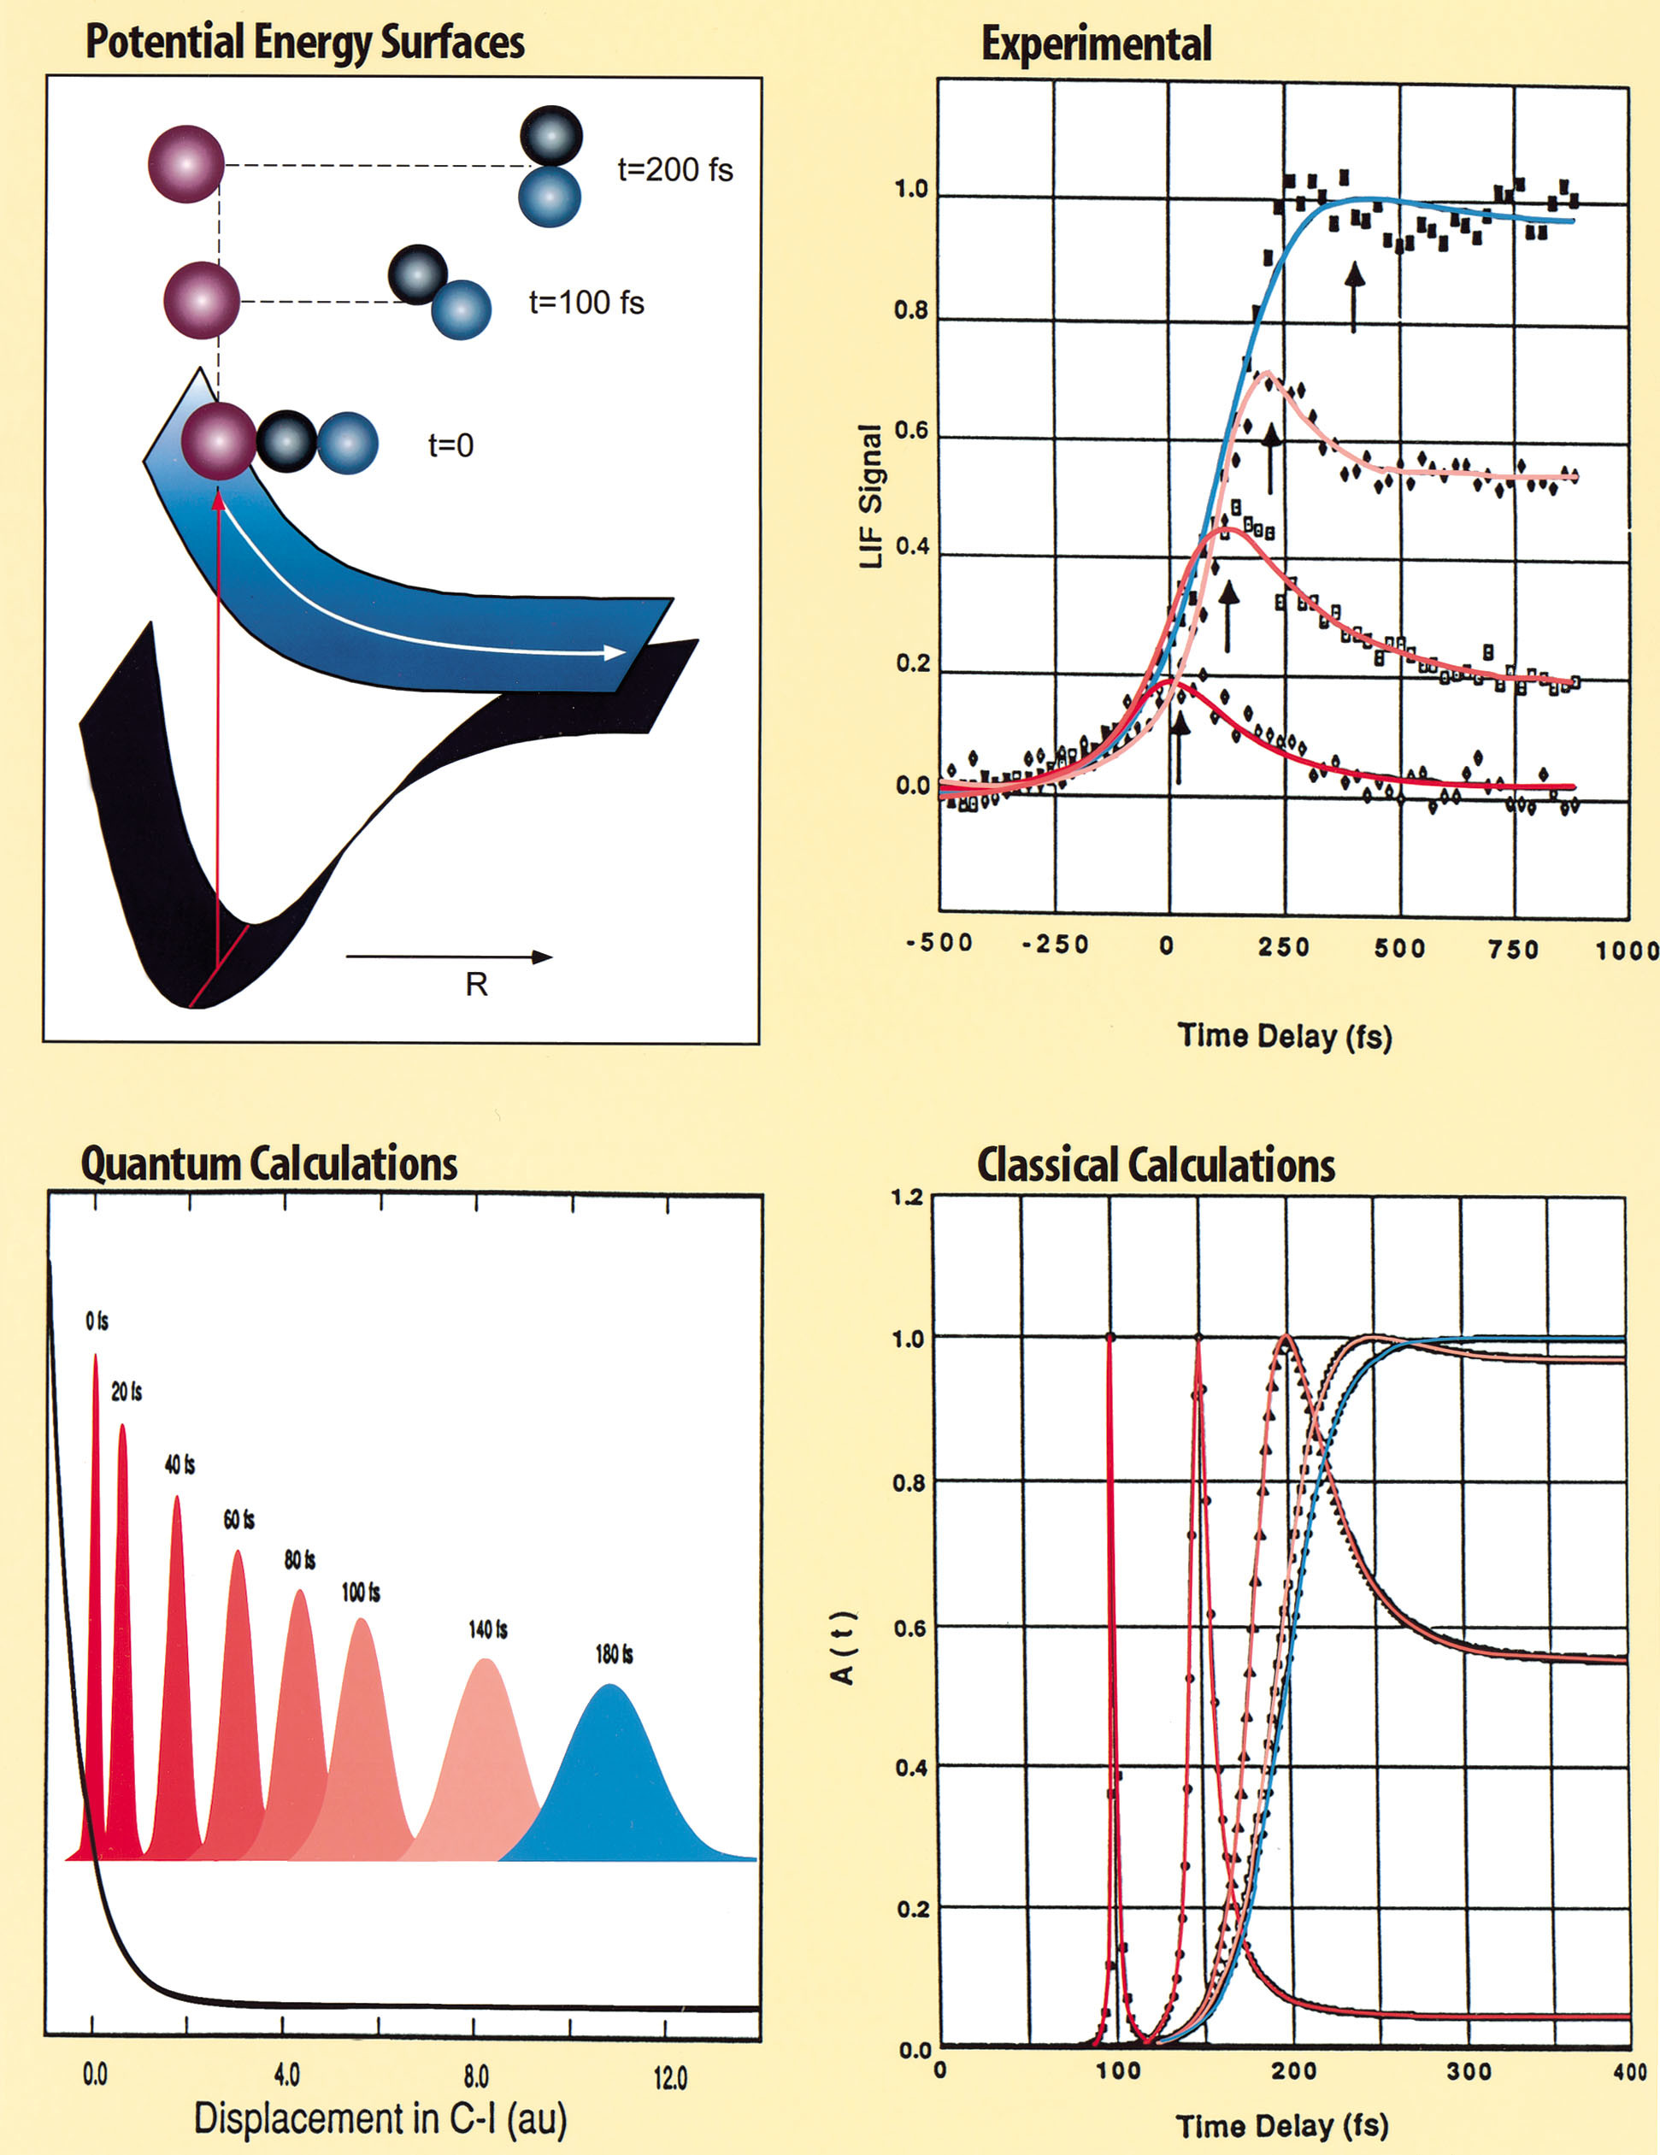

Pushing the limits: femtosecond and faster chemical dynamics
Chemical processes within one molecule and between molecules can take place on extremely fast timescales
Experimentally, we can push fast enough in time resolution to actually catch the transition state of some classes of reactions
Ahmed Zewail
Nobel prize in 1999
“For his studies of the transition states of chemical reactions using femtosecond spectroscopy”

Slide 12
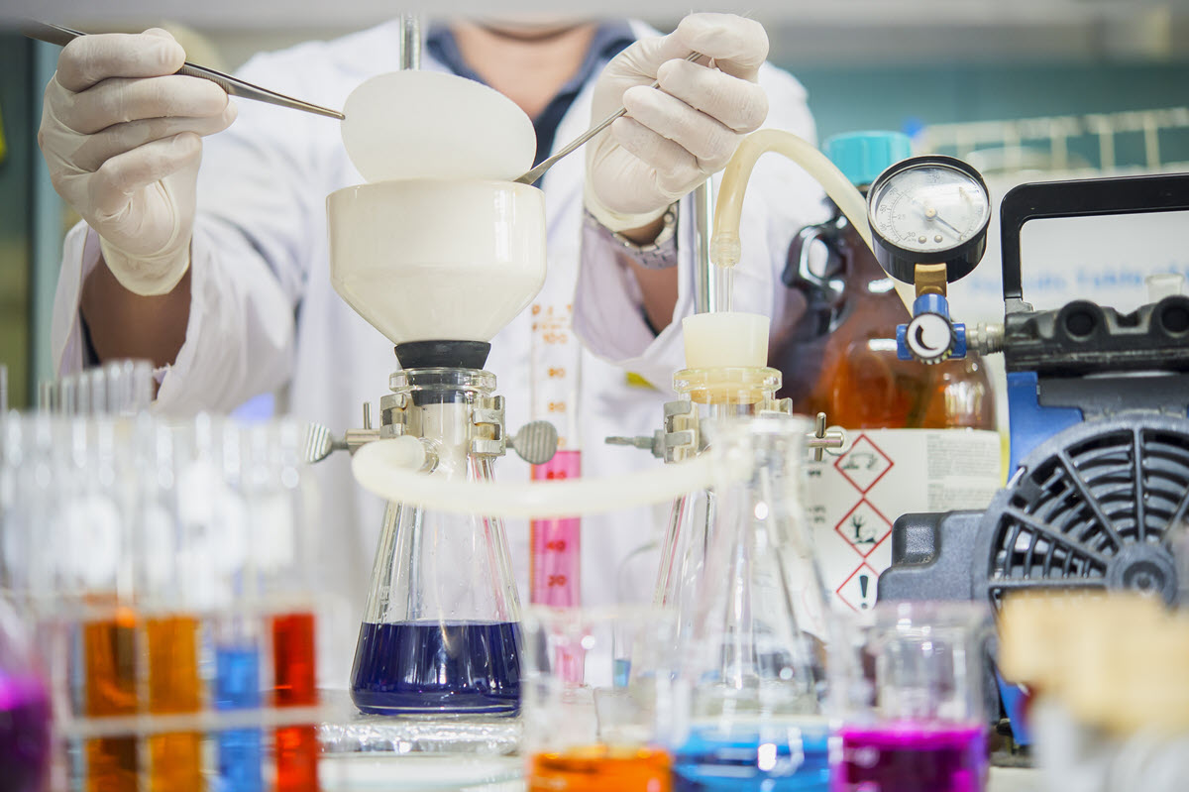
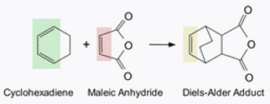
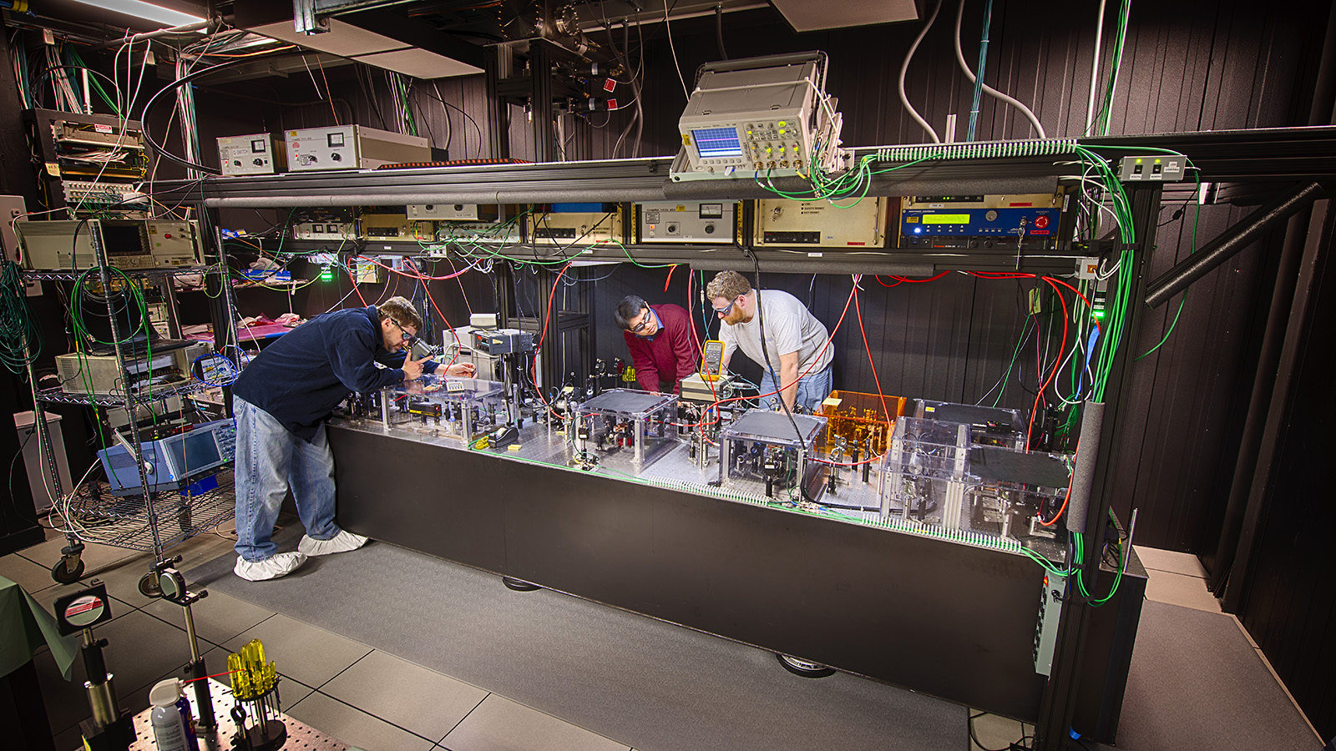

The faster we go, the more “physics-y” you get—can we get back?
I-CN
Also, the techniques seem to be much more specialized…
Pulsed laser sources can cost as much as a Lamborghini
  Utilizing femtosecond lasers to their fullest potential requires extensive training in linear and nonlinear optics, electronics, and programming
Organic chemistry, inorganic chemistry, biochemistry
Physical chemistry

Slide 13
At the intersection of physical, organic, and inorganic chemistry

Slide 14
Ultrafast Spectroscopy Uncovers the Mechanistic Underpinnings of Next-Generation Photocatalysts
v
v
Bryan Kudisch
Assistant Professor
Department of Chemistry & Biochemistry
Florida State University
Photochemistry Café, July 16th, 2024

Slide 15
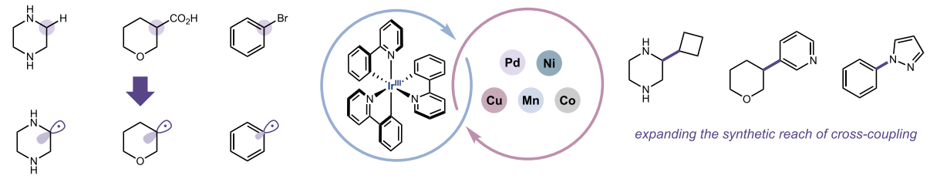

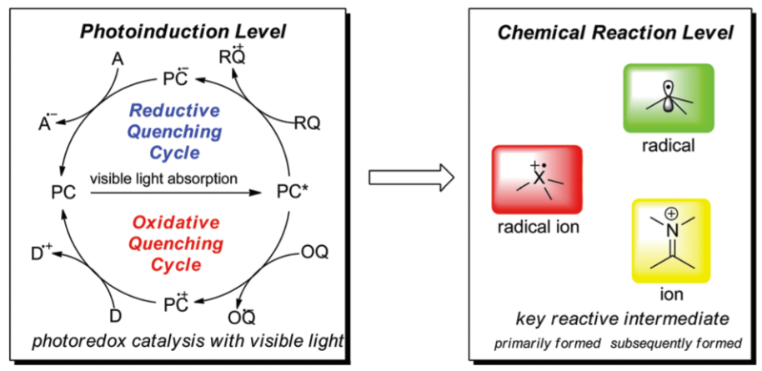
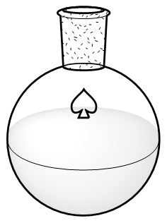
Photoredox catalysis: entryway into modern radical organic chemistry
Photochemical
Step
Chemical
Step
Valuable products
Utilize light to generate high energy, reactive intermediates

Slide 16
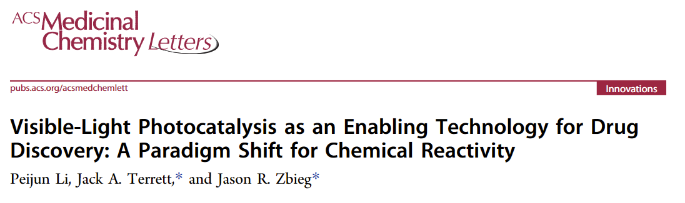
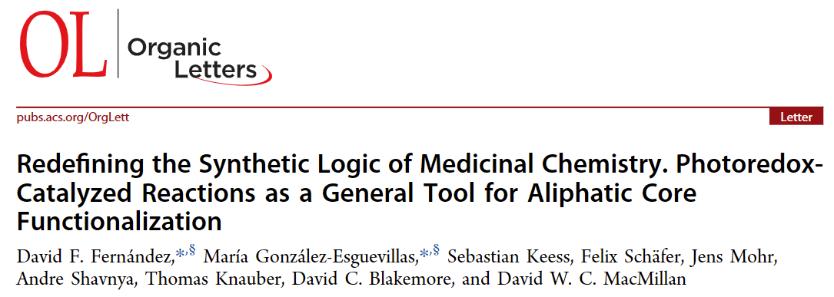
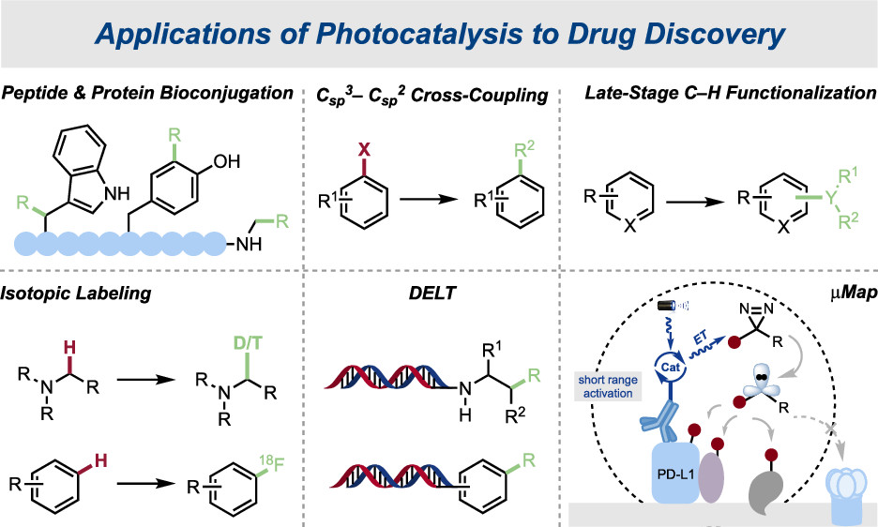
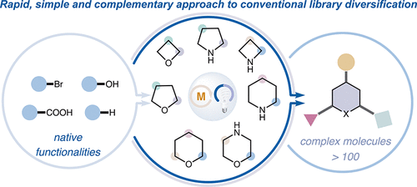




Photoredox in medicinal chemistry

Slide 17
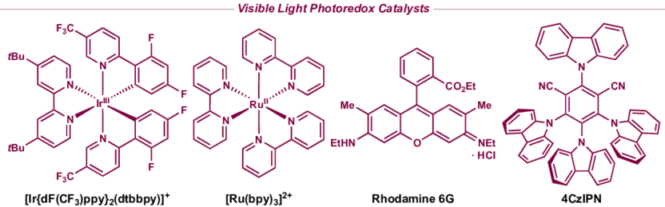
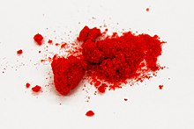
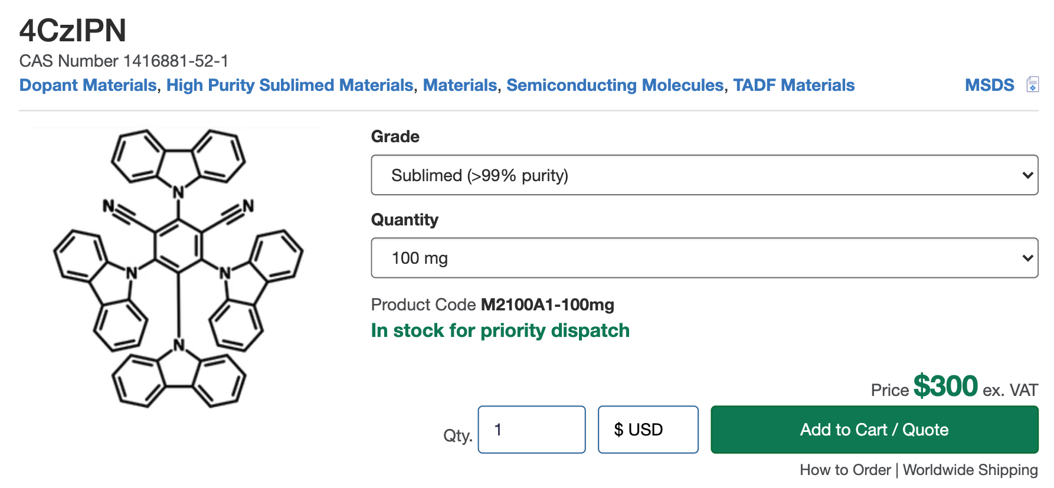
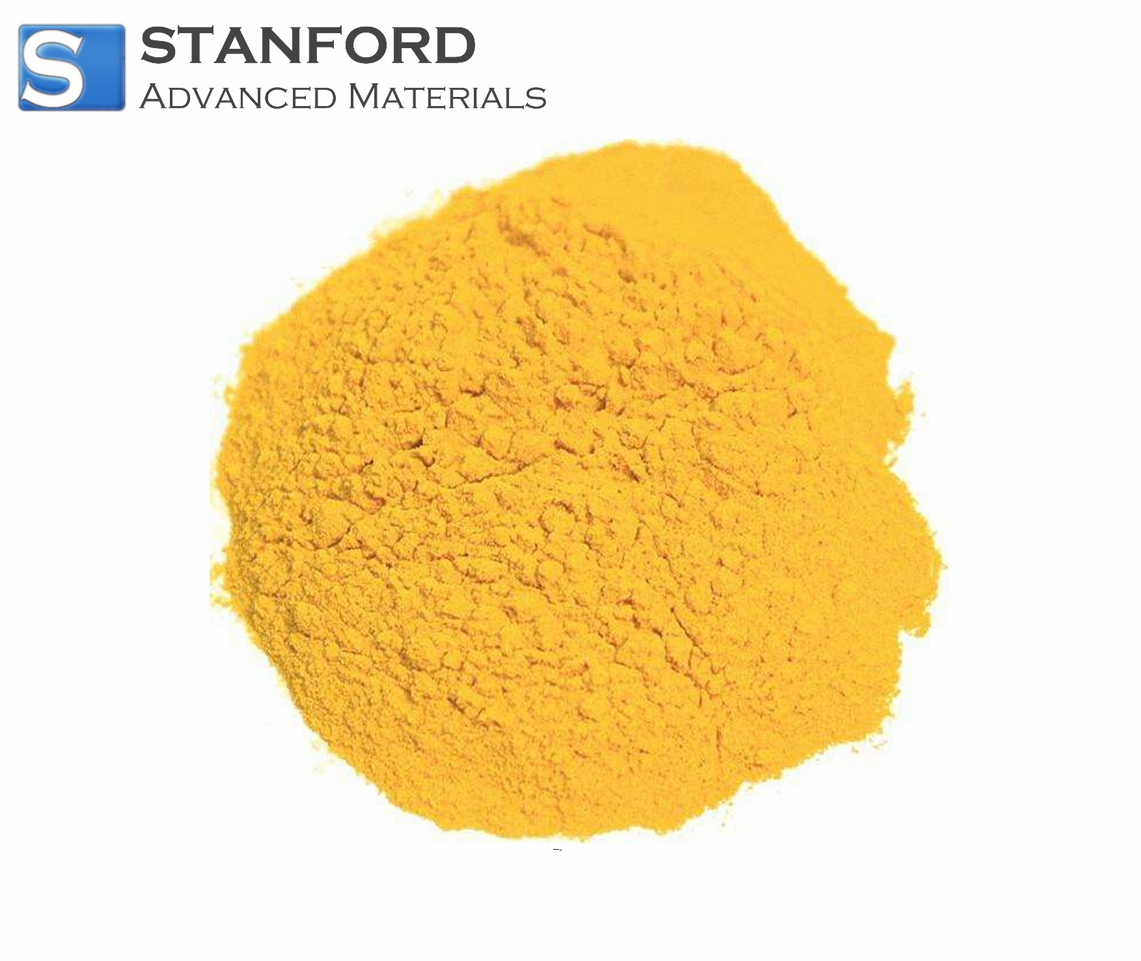
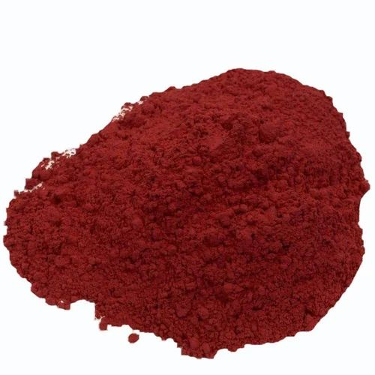
The classic, workhorse photoredox catalysts
1-3 steps to make from commercially available precursors
Air stable
Some incorporate “rare earth” metals like Ir, Ru, and Os

Slide 18
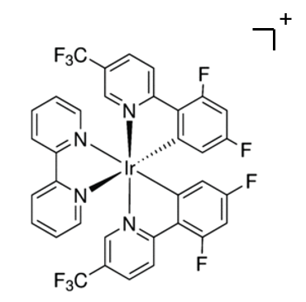
The underlying inorganic and physical chemistry
MLCT excited state
Highly redox- active/reactive excited-state
Resistant to decomposition in photochemical conditions
Long-lived excited state (>10 ns)

Slide 19
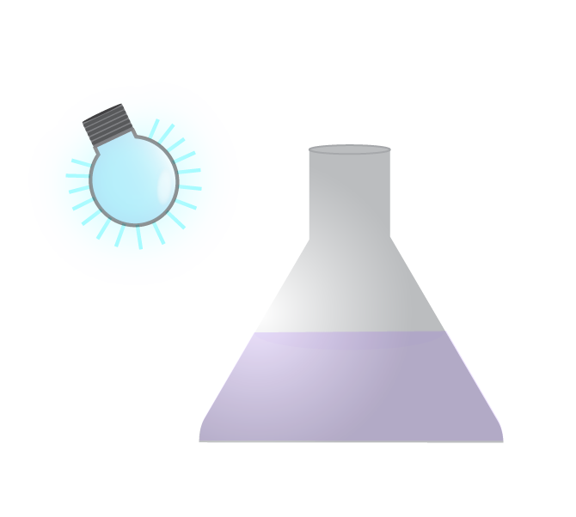





Desirable properties of next-gen photocatalysts
-More reactive
-More selective
-High photonic efficiency
-Improved cost efficiency
-More biocompatible

Slide 20
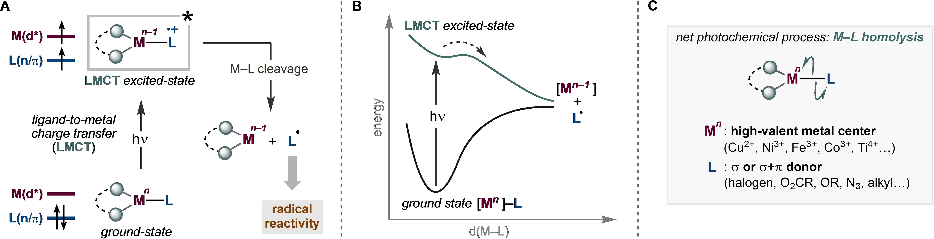
Ligand-to-metal charge transfer (LMCT) photoredox
Juliá, F. ChemCatChem. 2022

Slide 21
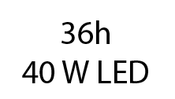


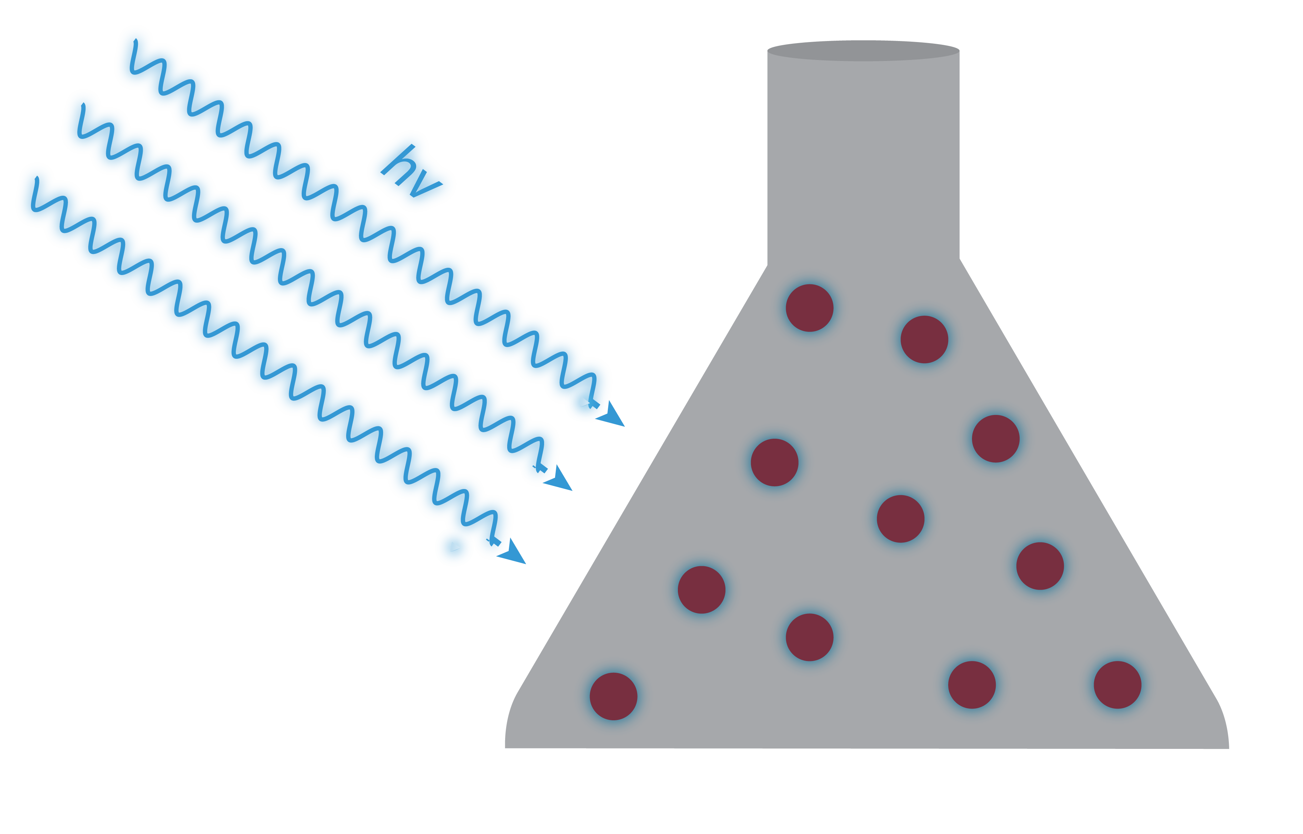
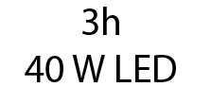
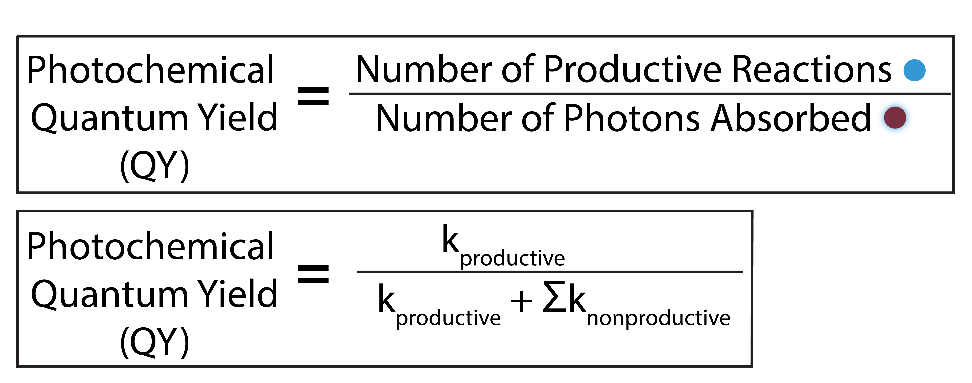
A clear impetus for mechanistic inquiry
Generating ligand radicals through bond rupture is not the predominant decay pathway, so what is?
QY ≈ 10 ⁻⁵

Slide 22
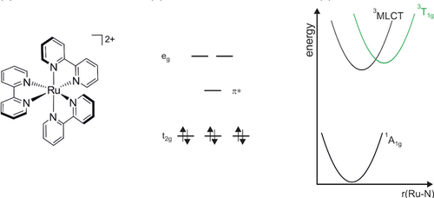
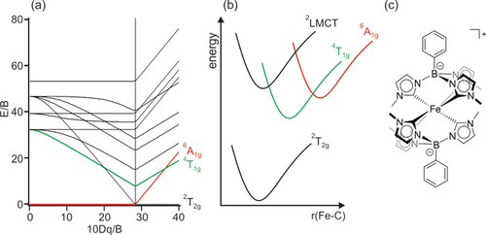
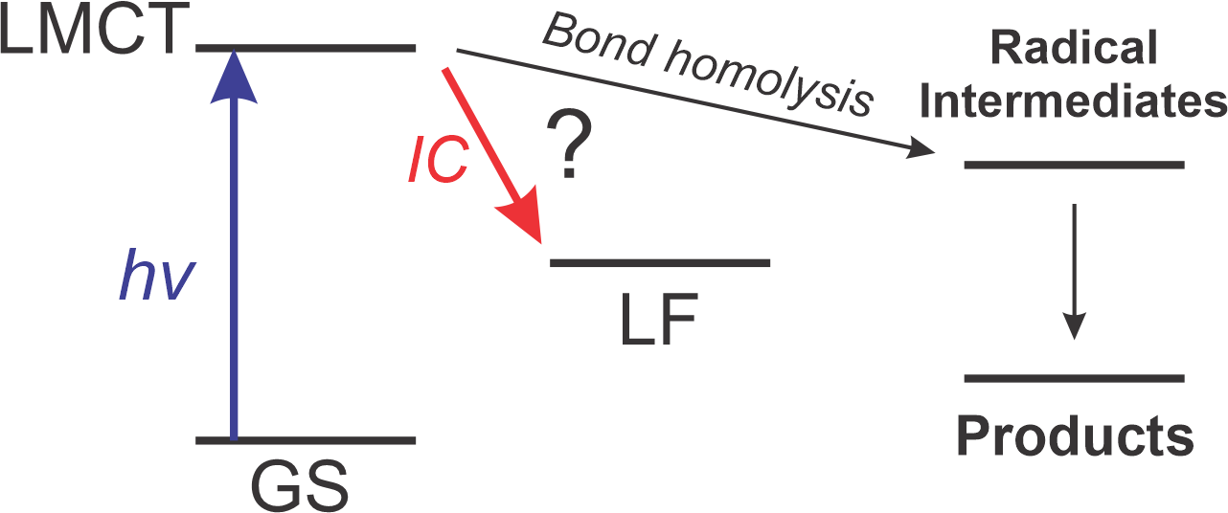
Classically, Fe and other 1st row metals are supposed to be bad photocatalysts!
A whole field emerged trying to deal with Fe LF deactivation
MLCT lifetime: 930 ns
Ag(II) d⁹, Cu(II) d⁹, and Fe(III) d⁵ all have partially filled d-orbitals!
MLCT lifetime: < 1 ps
Wenger, O. Chem. Eur. J. 2019

Slide 23
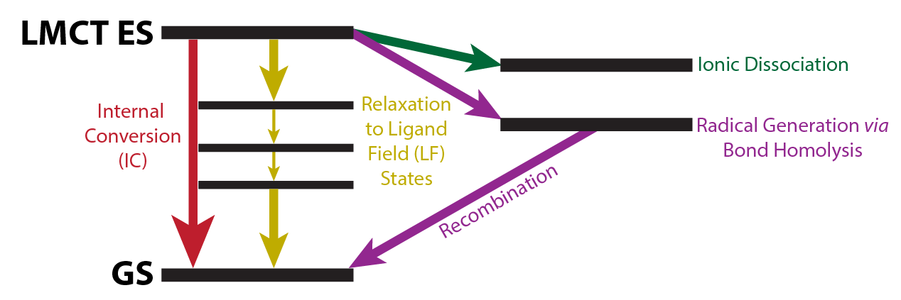
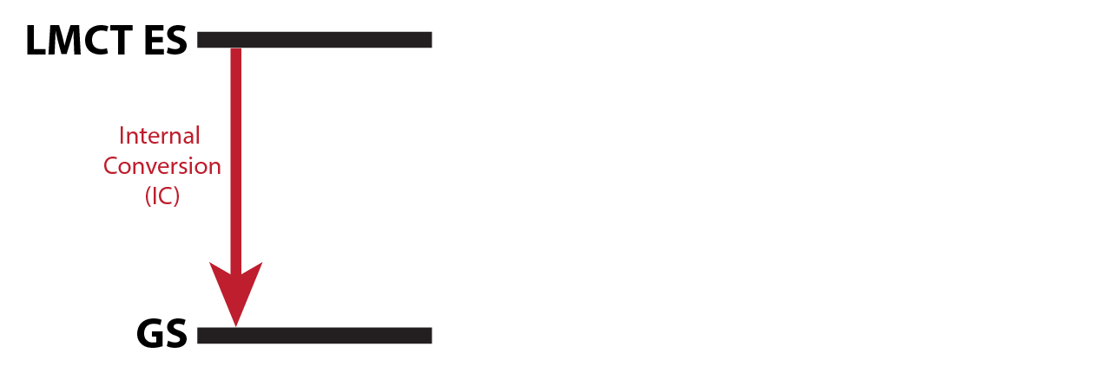
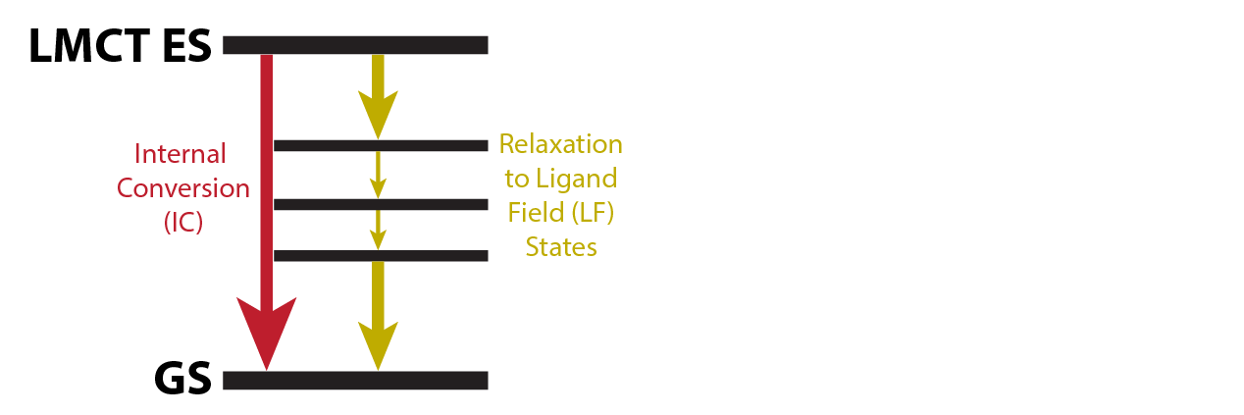
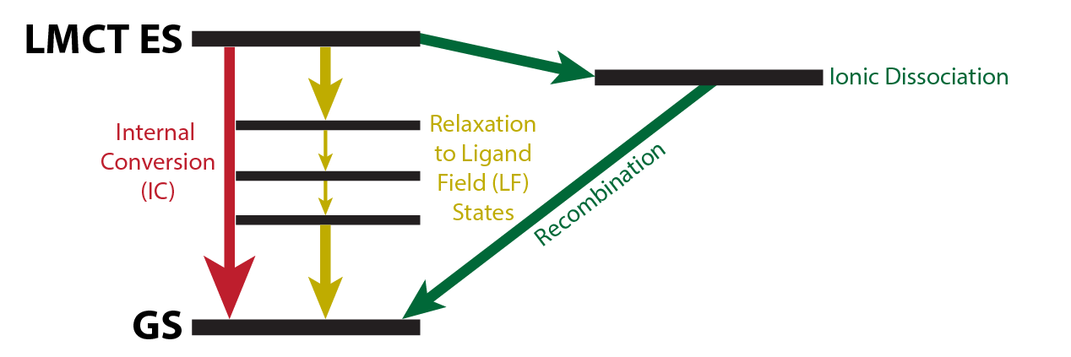
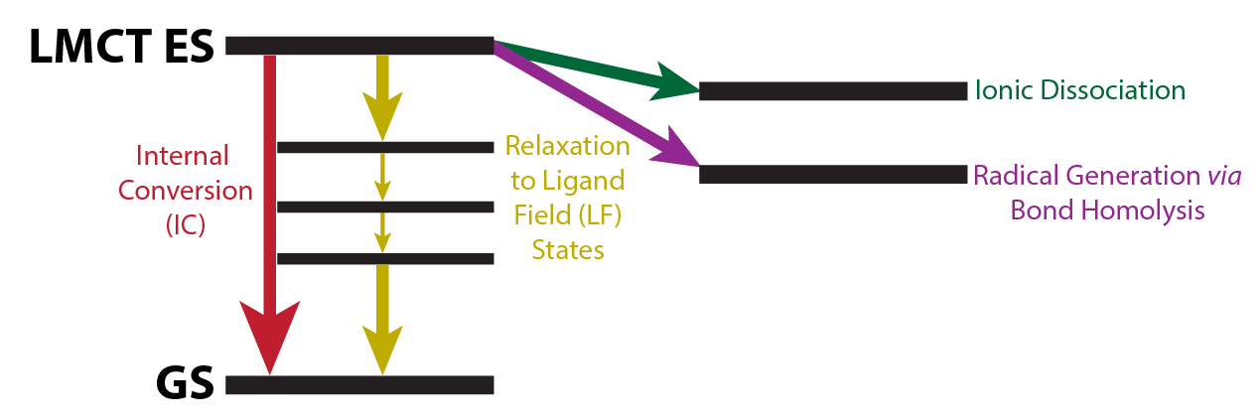
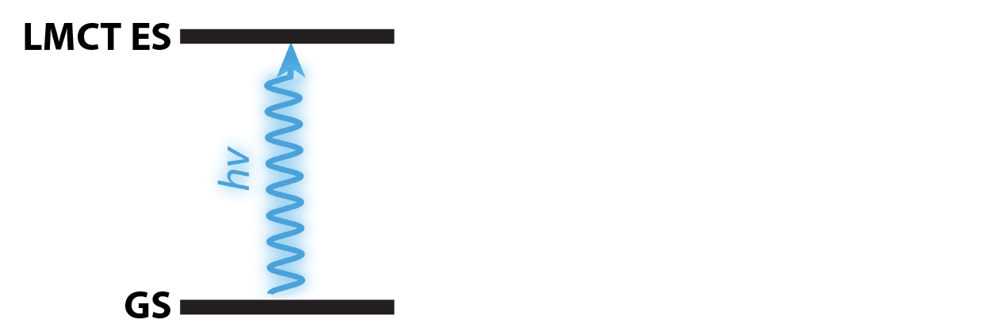
Competing Decay Pathways
Ultrafast Processes: 10⁻¹⁵-10⁻¹² s
(fs to ps)
k_{productive}
QY =
k_{productive} + Σk_{nonproductive}
Metal Chlorides
Demonstrated utility
Generation of Cl•
Inexpensive
Understand photoinduced dynamics

Slide 24
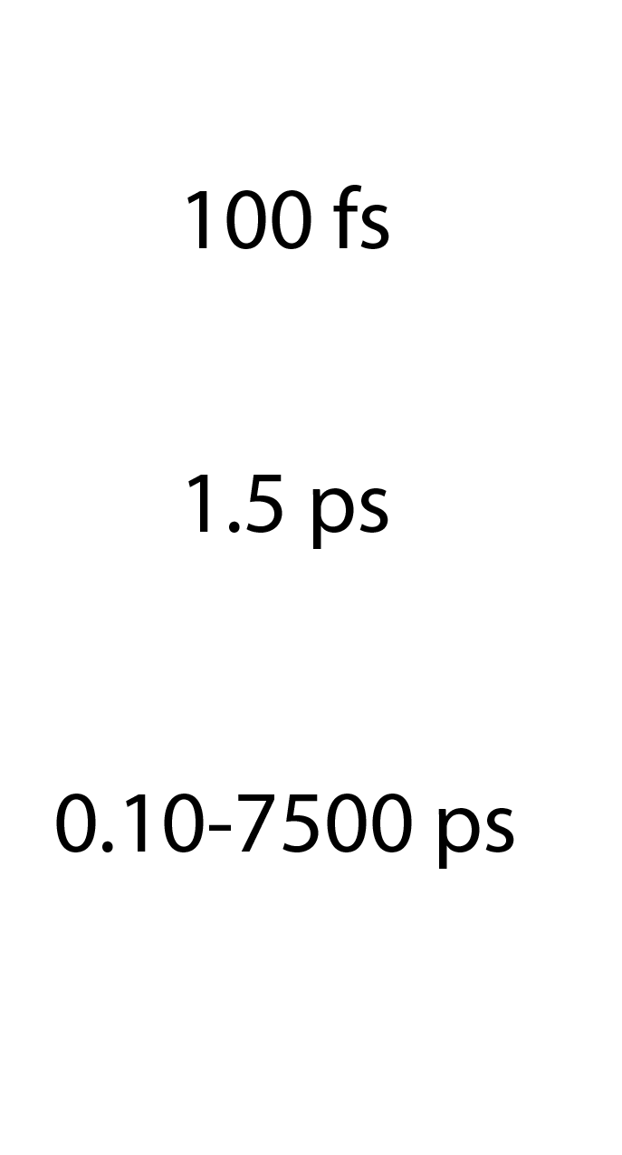
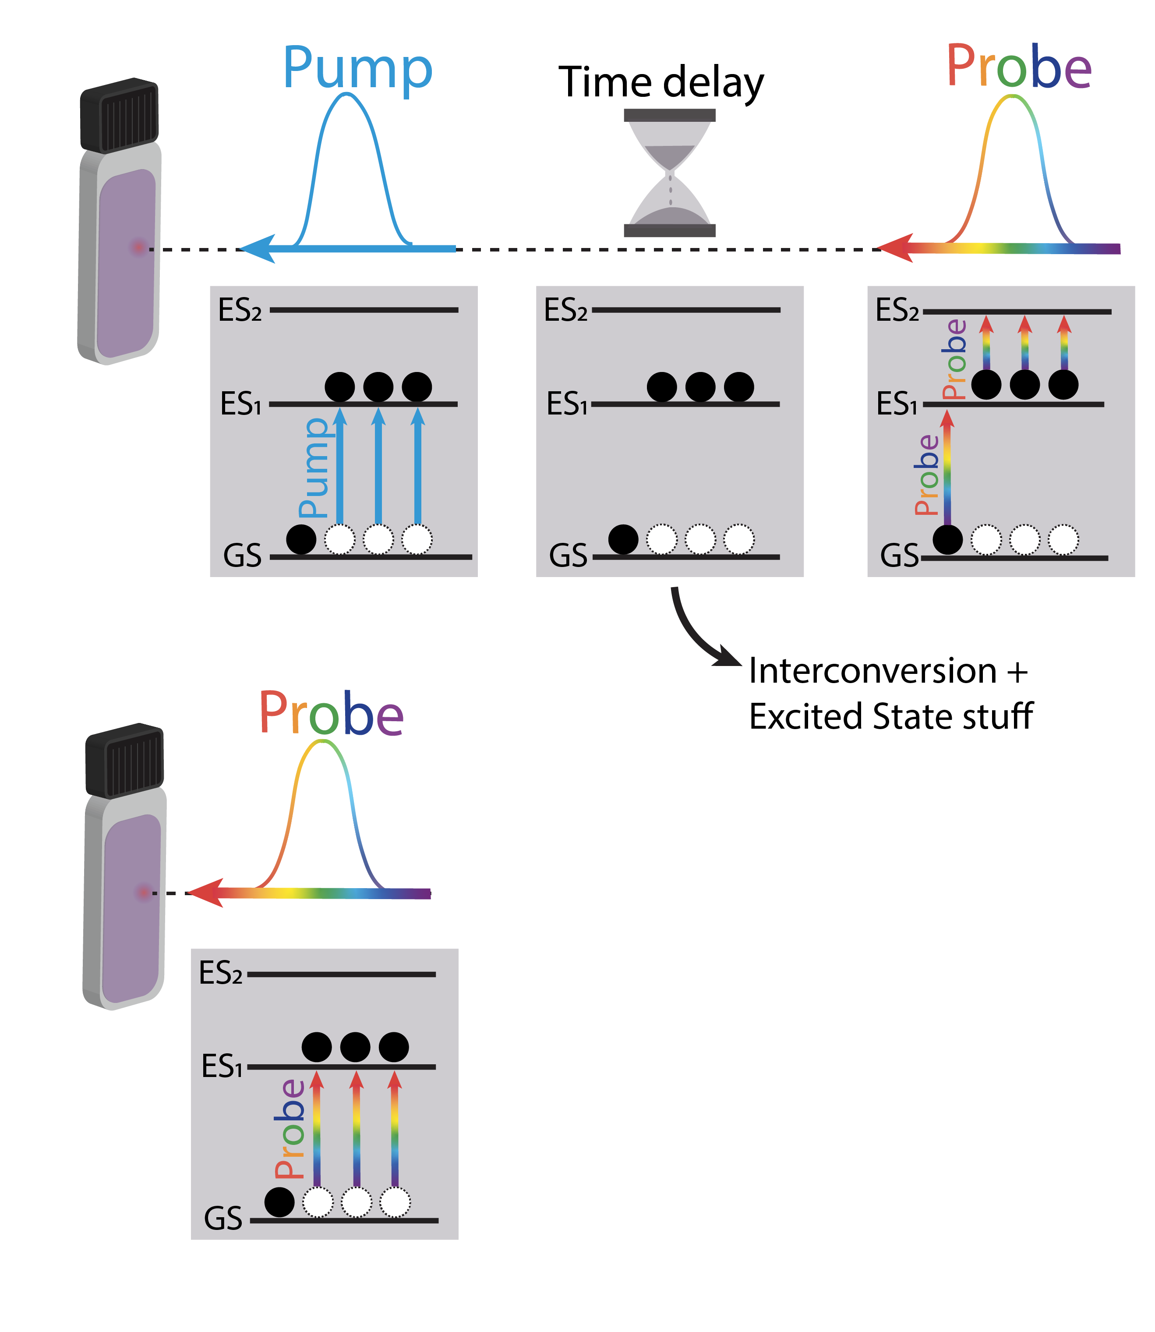
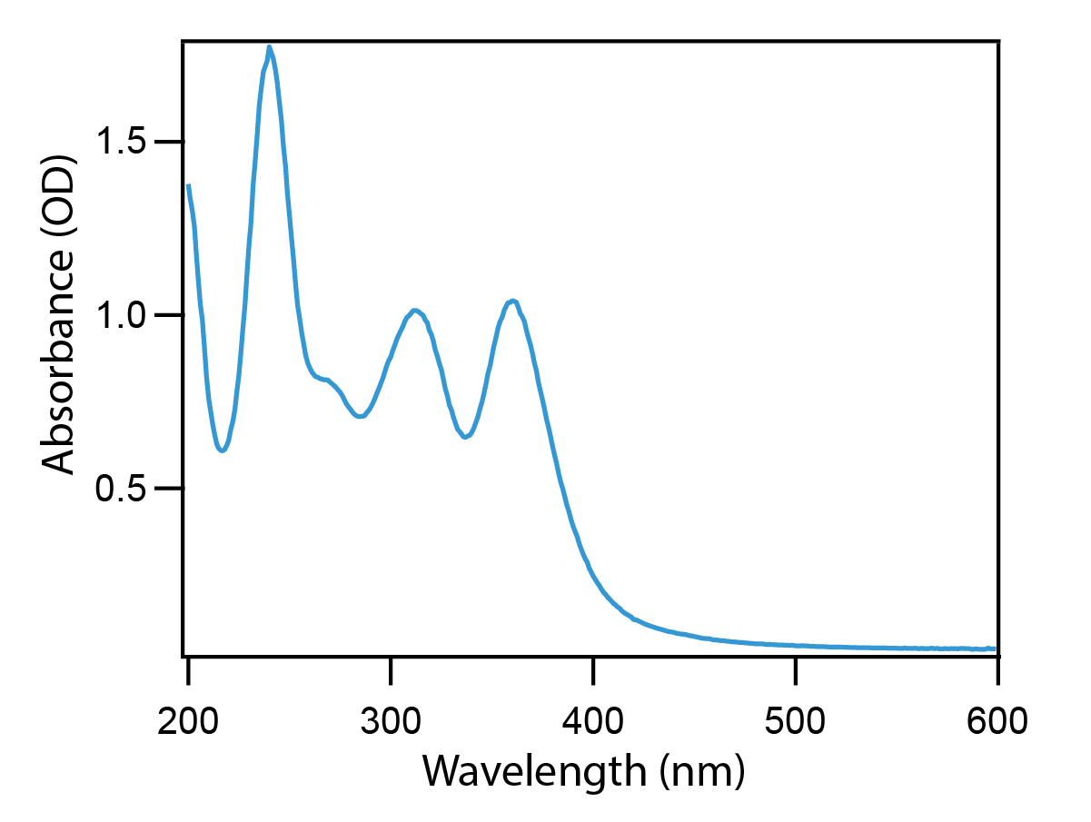





Intro to ultrafast transient absorption (TA)
Steady State Absorption Spectroscopy (UV-Vis)
Ultrafast Transient Absorption Spectroscopy (fs-TA)
Excited State Absorption (ESA)
LMCT Band 365 nm
Ground State Bleach (GSB)

